Slide 1





E-COMMERCE SALES ANALYSIS
Project by : BHUVANESH.KR
bhuvaneshkr2003@gmail.com
912421114002
1DFA1F1233D2DDA882B4B949989D9AFD
(au912421114002)
Guide: P.RAJA
(Master trainer edunet foundation)
Notes:
Slides: Prepare a short slide deck (10-12 slides) summarizing the project objectives, methodology, and key results.

Slide 2
Abstract
E-COMMERCE SALES ANALYSIS
This project conducts a comprehensive analysis of e-commerce sales data to uncover key patterns and insights into customer demographics, purchasing behavior, and seasonal trends. By examining various factors, including
gender distribution,
popular product categories,
preferred payment methods,
customer interaction types, and
purchase frequency.
This analysis equips decision-makers with data-driven insights to enhance platform performance and customer experience.

Slide 3
Problem Statement
E-COMMERCE SALES ANALYSIS
The objective is to analyze sales data to extract crucial information such as total sales, best-selling products, customer purchase patterns, and other vital metrics. The analysis helps the company better understand its performance, optimize marketing strategies, and improve inventory management.

Slide 4
E-COMMERCE SALES ANALYSIS
Proposed Solution
To calculate the total sales over a certain period.
To identify the best-selling products based on units sold and revenue.
To study customer purchase patterns, such as how often they buy and how much they spend.
To offer insights that will help the company improve marketing, manage stock, and engage customers better.
The analysis provides actionable insights into sales performance, enabling the company to optimize marketing efforts, adjust inventory, and target customer segments more effectively

Slide 5
System Architecture
E-COMMERCE SALES ANALYSIS
Data Collection
Data Processing
Model Training
Model Deployment
Predictions

Slide 6
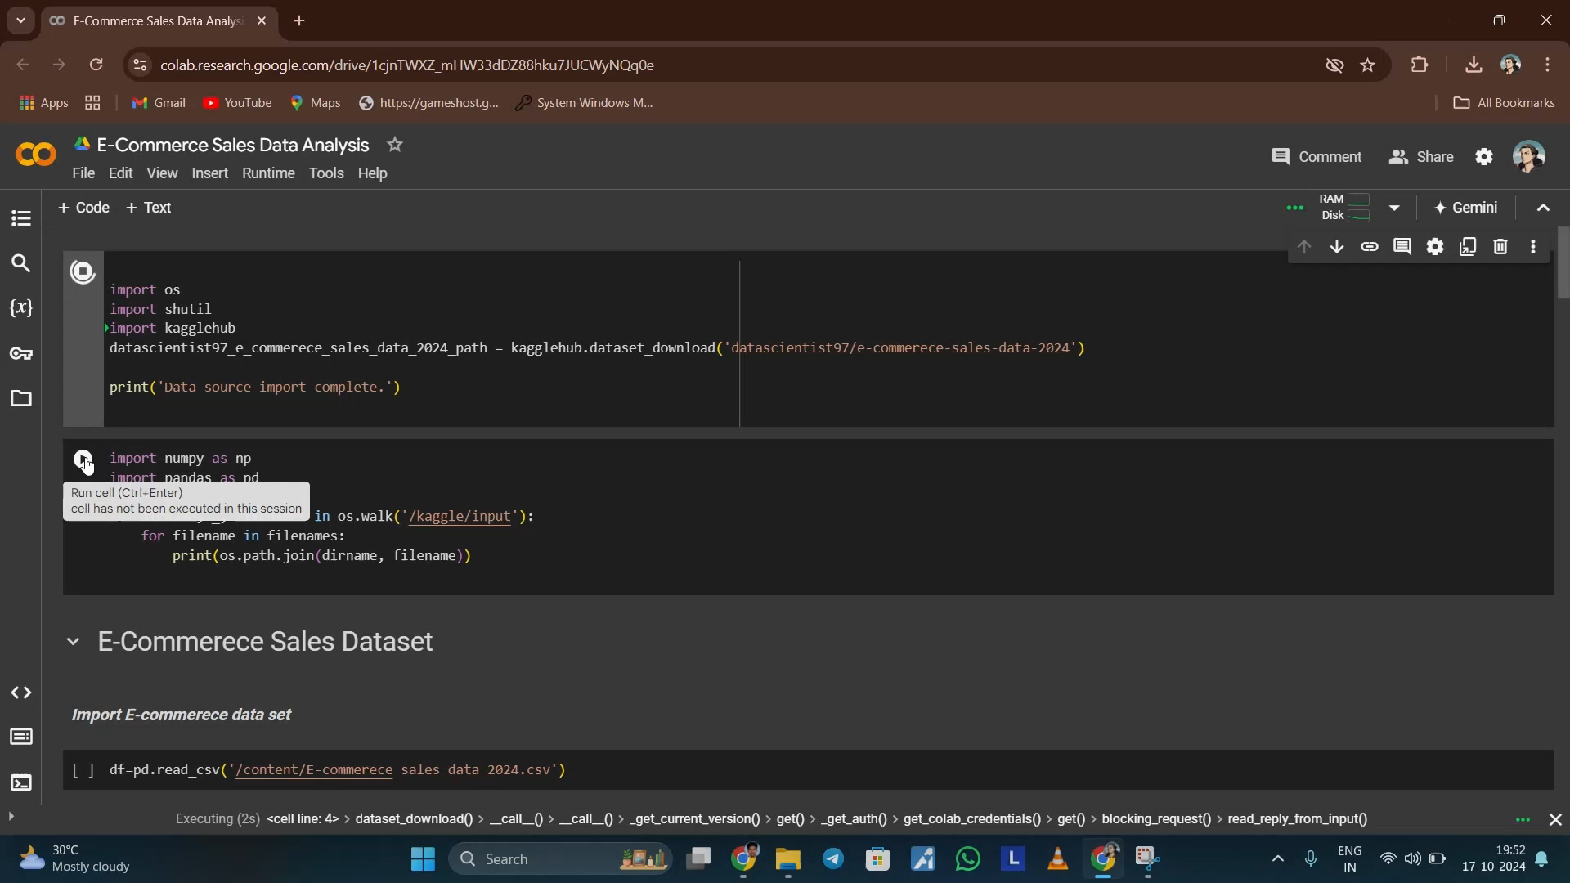
Video of Project Demo
E-COMMERCE SALES ANALYSIS

Slide 7
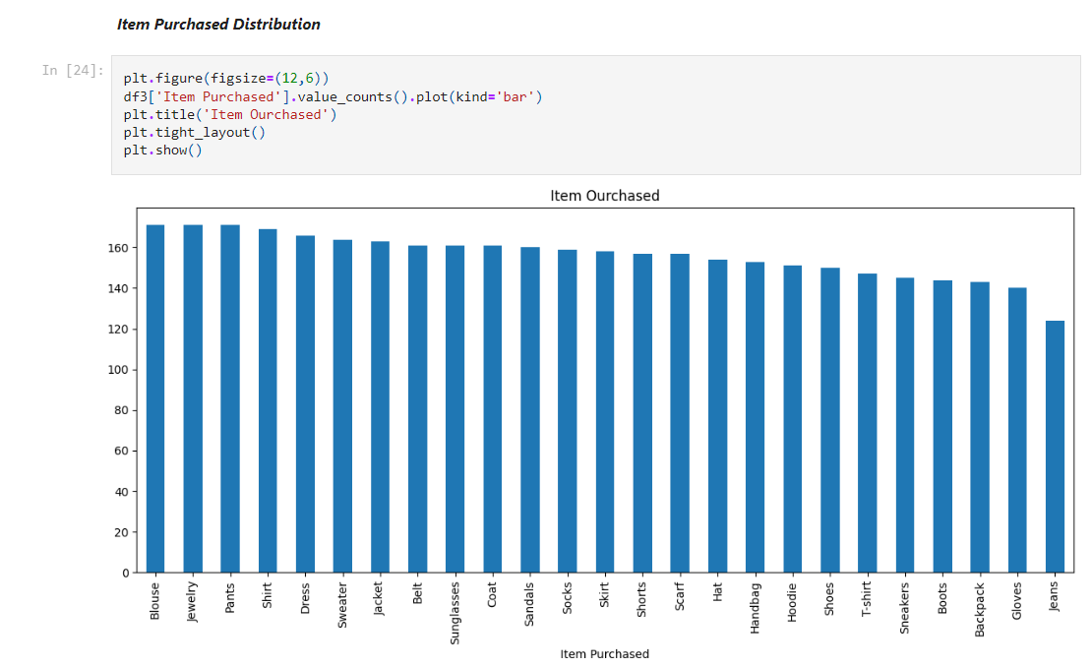
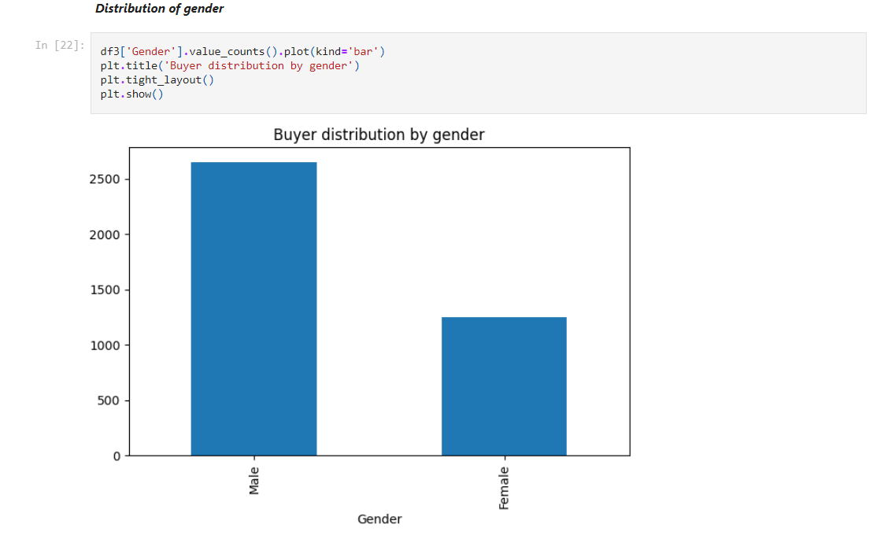
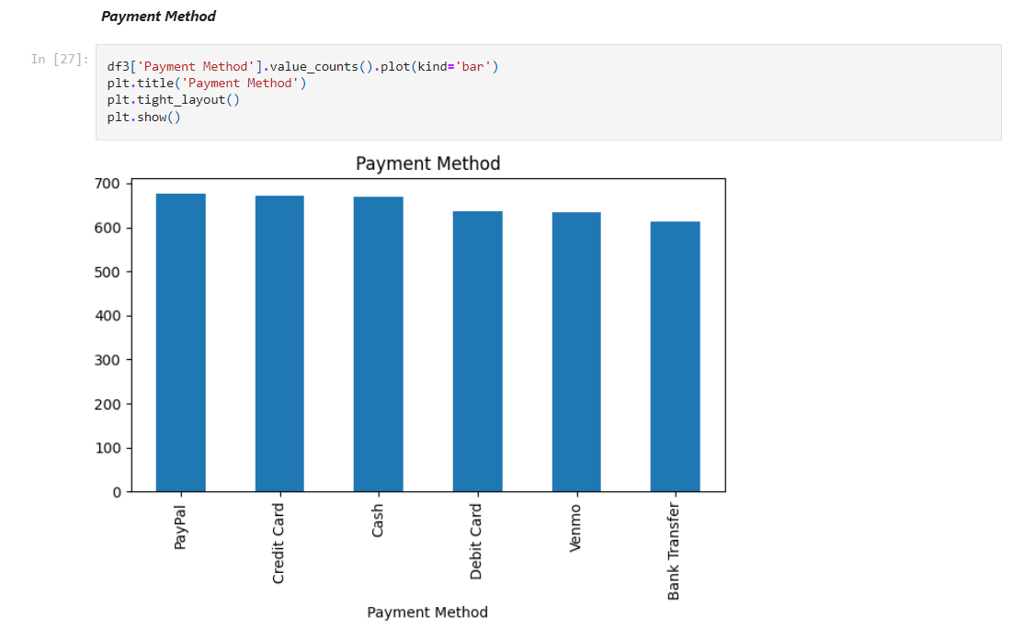
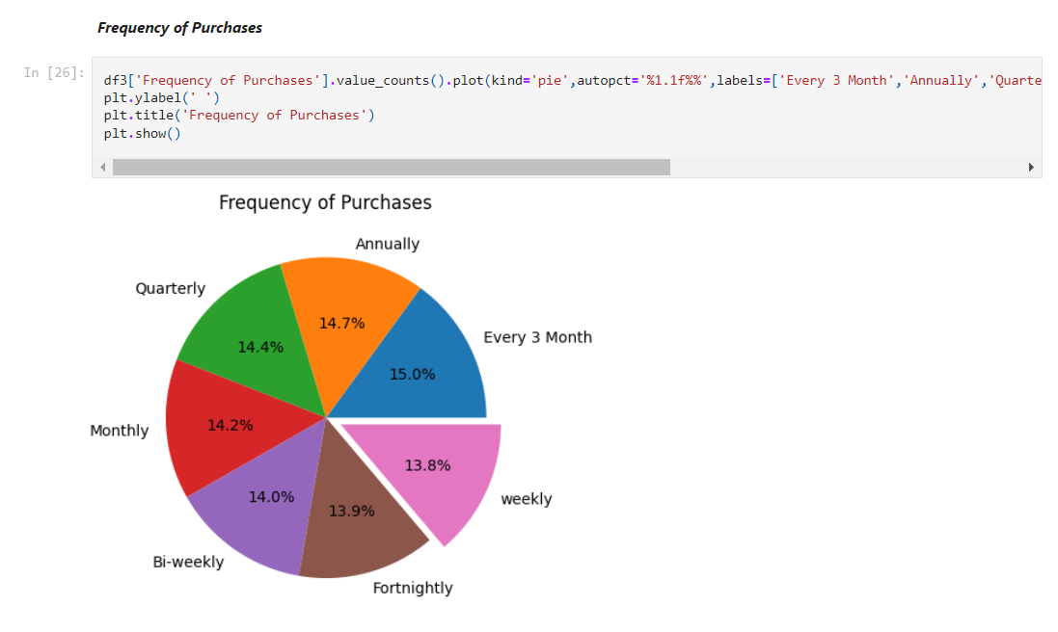
E-COMMERCE SALES ANALYSIS

Slide 8
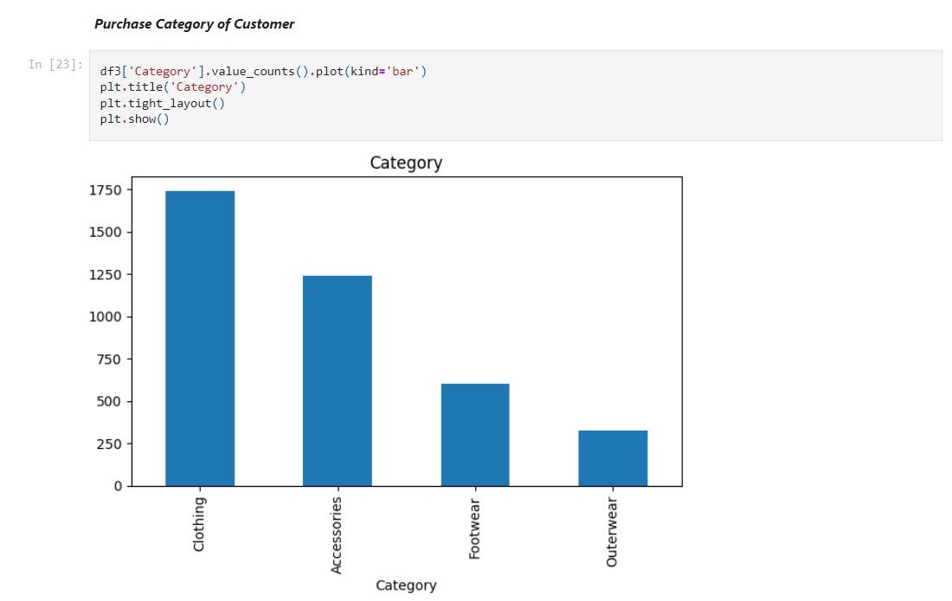
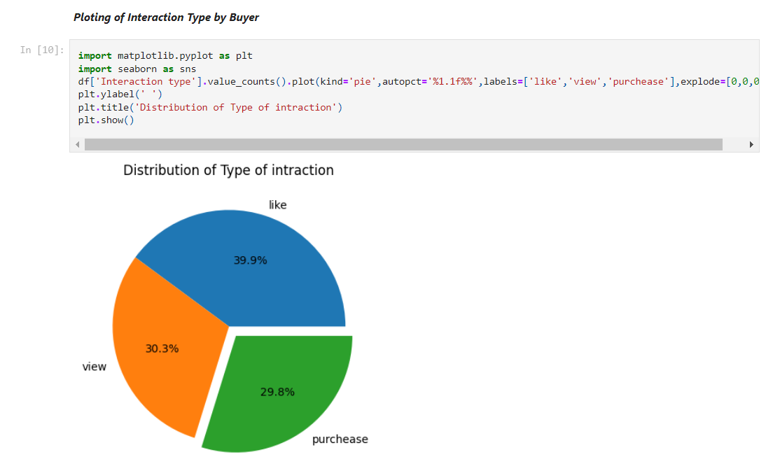
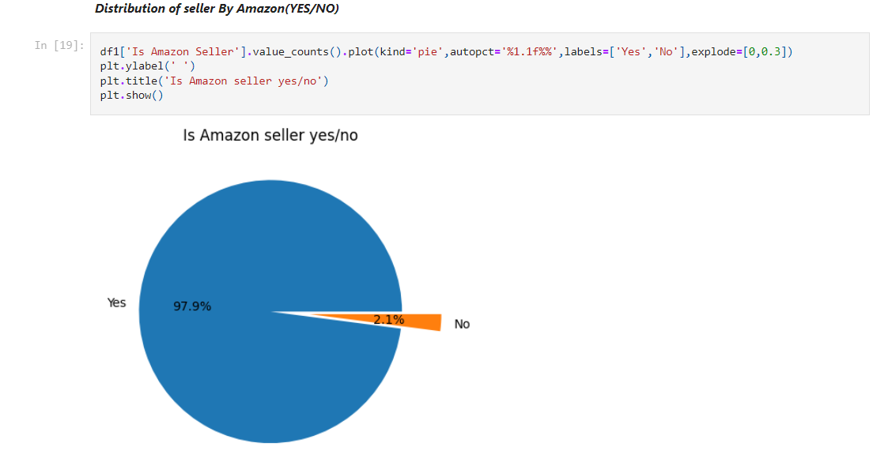
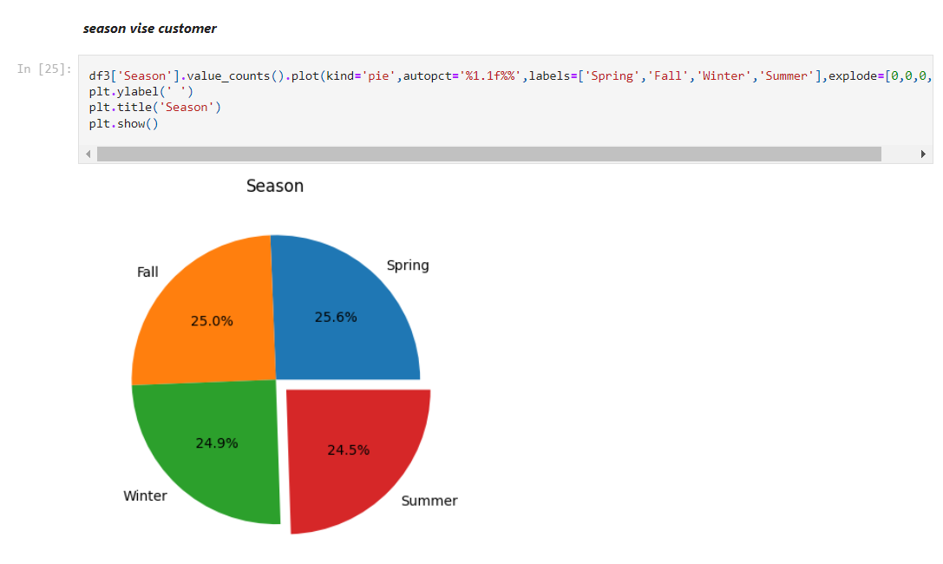
E-COMMERCE SALES ANALYSIS

Slide 9
Conclusion
E-COMMERCE SALES ANALYSIS
The analysis provides actionable insights into sales performance, enabling the company
to optimize marketing efforts,
adjust inventory, and
target customer segments more effectively,
ultimately driving revenue growth and improving customer satisfaction.
The project highlights key areas for enhancing user experience, particularly through checkout and product interaction improvements.

Slide 10
Future Scope
E-COMMERCE SALES ANALYSIS
This project can be expanded with predictive analytics and machine learning to forecast customer behavior and enhance recommendations.
Real-time data analysis can allow instant insights and personalized offers.
Adding sentiment analysis of reviews would provide a better understanding of customer satisfaction, while cross-channel analysis can reveal behavioral differences across platforms, improving targeted marketing.
Enhanced segmentation with psychographic data can enable highly personalized marketing and loyalty programs, boosting customer retention.

Slide 11
E-COMMERCE SALES ANALYSIS
Thank you!
Notes:
thank you very much for joining this PPT, keep learning.
11

